Slide 1
2
DERIVATIVES

Slide 2
2.5
The Chain Rule

Slide 3
The Chain Rule
Suppose you are asked to differentiate the function
The differentiation formulas you learned in the previous sections of this chapter do not enable you to calculate F’(x).

Slide 4
The Chain Rule
Observe that F is a composite function. In fact, if we let
and let u = g(x) = x² + 1, then we can write y = F(x) = f (g(x)).
That is, F = f ◦ g.
We know how to differentiate both f and g.
So, it would be useful to have a rule that shows us how to find the derivative of F = f ◦ g in terms of the derivatives of f and g.

Slide 5
The Chain Rule
The derivative of the composite function f ° g is the product of the derivatives of f and g.
This fact is one of the most important of the differentiation rules and is called the Chain Rule.
It seems plausible if we interpret derivatives as rates of change.

Slide 6
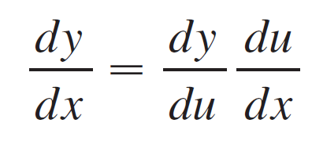
The Chain Rule
Regard du/dx as the rate of change of u with respect to x, dy/du as the rate of change of y with respect to u, dy/dx and as the rate of change of y with respect to x.
If u changes twice as fast as x and y changes three times as fast as u, then it seems reasonable that y changes six times as fast as x, and so we expect that

Slide 7
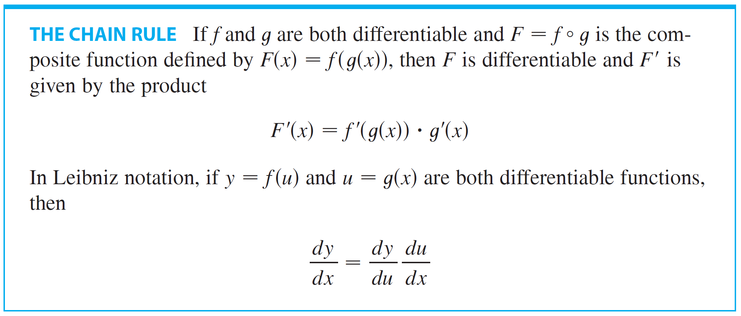
The Chain Rule

Slide 8
COMMENTS ON THE PROOF OF THE CHAIN RULE
Let ∆u be the change in corresponding to a change of ∆x in x, that is, ∆u = g(x + ∆x) – g(x)
Then, the corresponding change in y is: ∆y = f(u + ∆u) – f(u)

Slide 9
COMMENTS ON THE PROOF OF THE CHAIN RULE
It is tempting to write:

Slide 10
COMMENTS ON THE PROOF OF THE CHAIN RULE
The only flaw in this reasoning is that, in Equation 1, it might happen that ∆u = 0 (even when ∆x ≠ 0) and, of course, we can’t divide by 0.
Nonetheless, this reasoning does at least suggest that the Chain Rule is true.
A full proof of the Chain Rule is given at the end of the section.

Slide 11




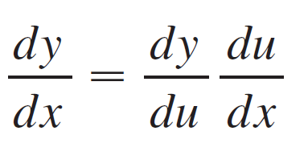

The Chain Rule
The Chain Rule can be written either in the prime notation
or, if and in Leibniz notation:
Equation 3 is easy to remember because if dy/du and du/dx were quotients, then we could cancel du. Remember, however, that du has not been defined and du/dx should not be thought of as an actual quotient.

Slide 12
Example 1
Find F’(x) if
SOLUTION 1
One way of solving this is by using Equation 2.
At the beginning of this section, we expressed F as F(x) = (f ◦ g))(x) = f(g(x)) where and g(x) = x² + 1.

Slide 13
Example 1 SOLUTION 1
Since we have

Slide 14
Example 1 SOLUTION 2
We can also solve by using Equation 3.
If we let u = x² + 1 and then

Slide 15
The Chain Rule
When using Formula 3, we should bear in mind that:
dy/dx refers to the derivative of y when y is considered as a function of x (called the derivative of y with respect to x)
dy/du refers to the derivative of y when considered as a function of u (the derivative of y with respect to u)

Slide 16
The Chain Rule
For instance, in Example 1, y can be considered as a function of x and also as a function of u .
Note that:

Slide 17
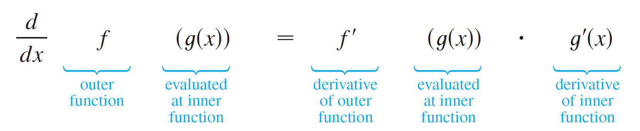
The Chain Rule
In using the Chain Rule we work from the outside to the inside.
Formula 2 says that we differentiate the outer function f [at the inner function g(x)] and then we multiply by the derivative of the inner function.

Slide 18
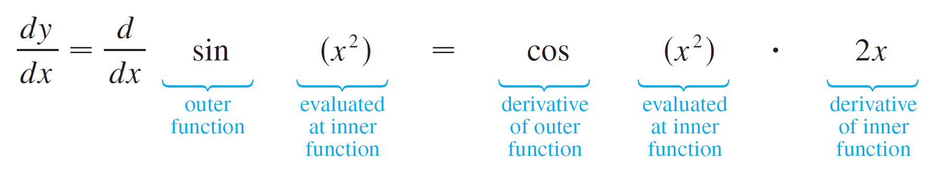
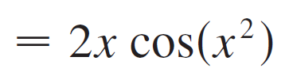
Example 2
Differentiate (a) y = sin(x²) and (b) y = sin²x.
Solution:
(a) If y = sin(x ²), then the outer function is the sine function and the inner function is the squaring function, so the Chain Rule gives

Slide 19
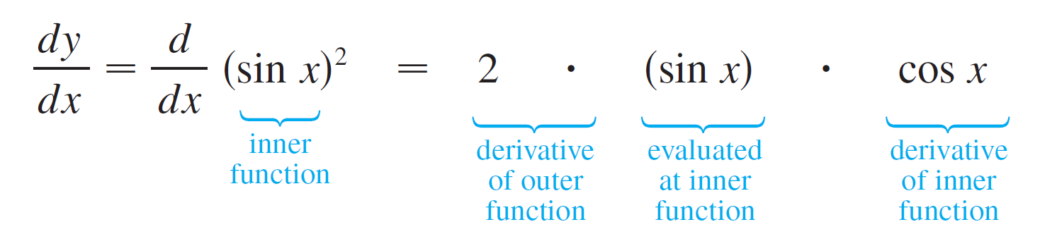
Example 2 – Solution
cont’d
(b) Note that sin²x = (sin x)². Here the outer function is the squaring function and the inner function is the sine function. So
The answer can be left as 2 sin x cos x or written as sin 2x (by a trigonometric identity known as the double-angle formula).

Slide 20
COMBINING THE CHAIN RULE
In Example 2(a), we combined the Chain Rule with the rule for differentiating the sine function.
In general, if y = sin u, where u is a differentiable function of x, then, by the Chain Rule,
Thus,

Slide 21
COMBINING THE CHAIN RULE
In a similar fashion, all the formulas for differentiating trigonometric functions can be combined with the Chain Rule.

Slide 22
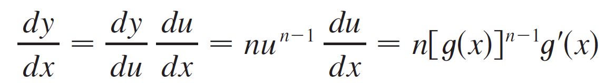
The Chain Rule
Let’s make explicit the special case of the Chain Rule where the outer function f is a power function.
If y = [g(x)]^{n}, then we can write y = f(u) = u^{n} where u = g(x).
By using the Chain Rule and then the Power Rule, we get

Slide 23
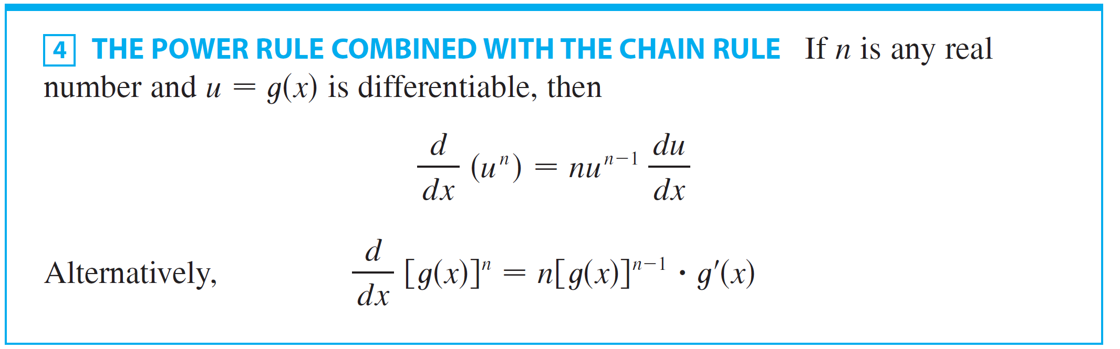
The Chain Rule

Slide 24
Example 3
Differentiate y = (x³ – 1)¹⁰⁰
SOLUTION
Taking u = g(x) = x³ – 1 and n = 100 in the rule, we have:

Slide 25
Example 4
Find f’ (x) if
SOLUTION
First, rewrite f as f(x) = (x² + x + 1)^{-1/3}
Thus,

Slide 26
Example 5
Find the derivative of
SOLUTION
Combining the Power Rule, Chain Rule, and Quotient Rule, we get:

Slide 27

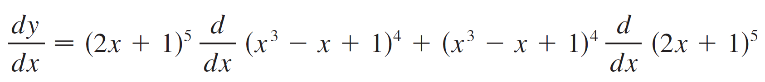
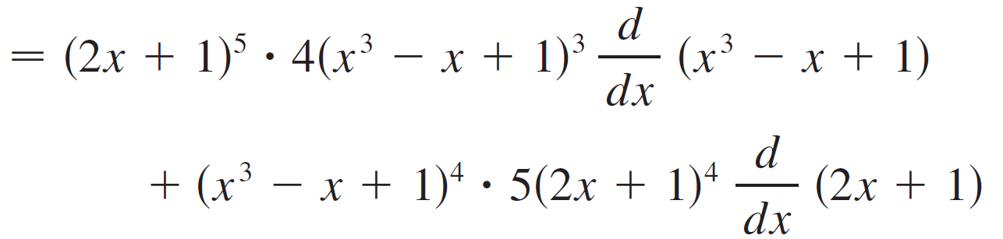
Example 6
Differentiate .
Solution:
In this example we must use the Product Rule before using the Chain Rule:

Slide 28

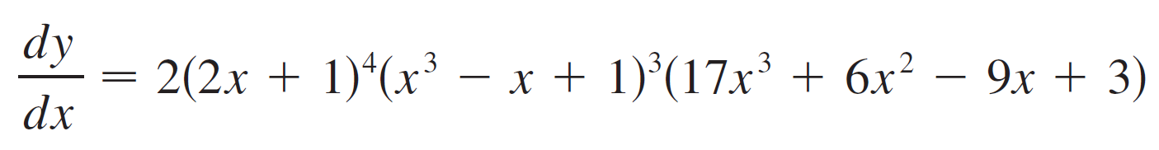
Example 6 – Solution
cont’d
Noticing that each term has the common factor , we could factor it out and write the answer as

Slide 29
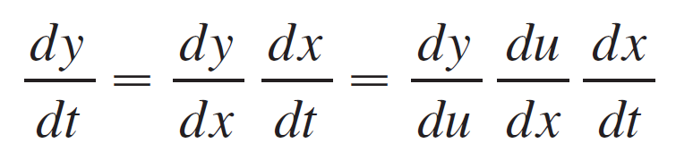
The Chain Rule
The reason for the name “Chain Rule” becomes clear when we make a longer chain by adding another link.
Suppose that y = f(u), u = g(x), and x = h(t), where f, g, and h are differentiable functions.
Then, to compute the derivative of y with respect to t, we use the Chain Rule twice:

Slide 30
Example 7
If
Notice that we used the Chain Rule twice.

Slide 31
Example 8
Differentiate .
SOLUTION
The outer function is the square root function, the middle function is the secant function, and the inner function is the cubing function.
Thus,

Slide 32
How to Prove the Chain Rule

Slide 33
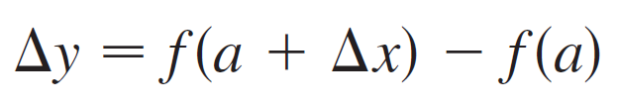
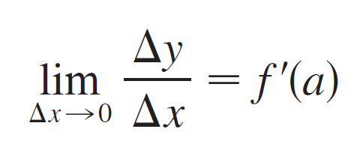
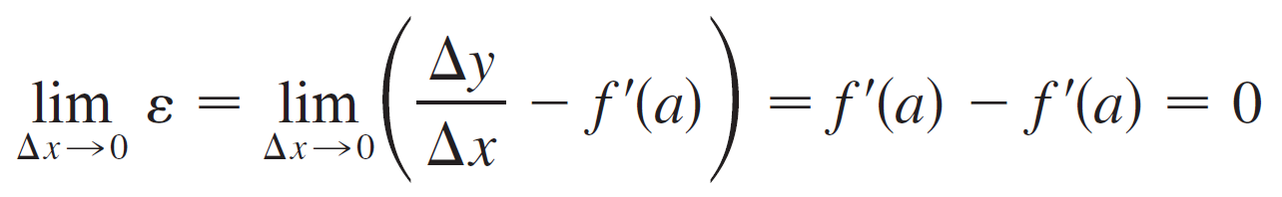
How to Prove the Chain Rule
If y = f(x) and x changes from a to a + Δx, we defined the increment of y as
According to the definition of a derivative, we have
So if we denote by ε the difference between the difference quotient and the derivative, we obtain

Slide 34
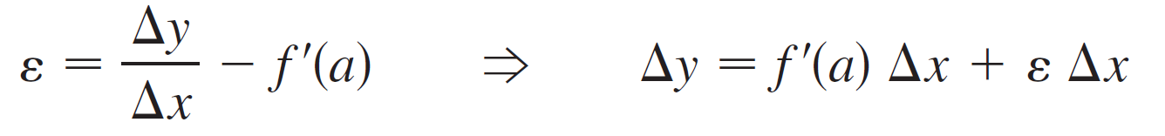
How to Prove the Chain Rule
But
If we define ε to be 0 when Δx = 0, then ε becomes a continuous function of Δx.
Thus, for a differentiable function f, we can write
and ε is a continuous function of Δx. This property of differentiable functions is what enables us to prove the Chain Rule.

Slide 35


How to Prove the Chain Rule
Proof of the Chain Rule
Suppose u = g(x) is differentiable at a and y = f(u) is differentiable at b = g(a).
If Δx is an increment in x and Δu and Δy are the corresponding increments in u and y, then we can use Equation 5 to write
where as .

Slide 36


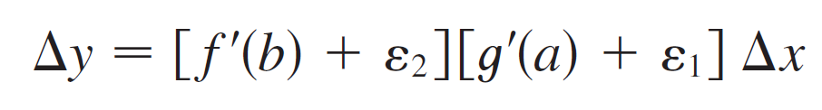
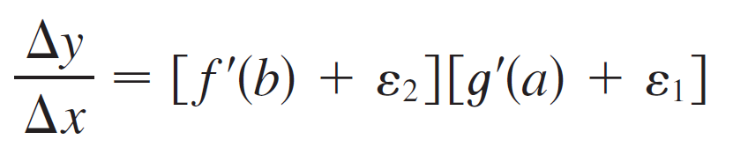
How to Prove the Chain Rule
Similarly
where as . If we now substitute the expression for Δu from Equation 6 into Equation 7, we get
so

Slide 37
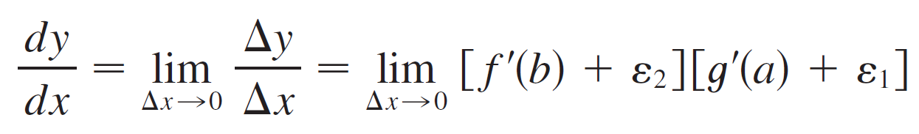
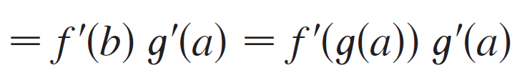
How to Prove the Chain Rule
As , Equation 6 shows that .
So both and as .
Therefore
This proves the Chain Rule.

